Slide 1
UNIT – I
AC CHARACTERISTICS

Slide 2
AC Characteristics
Op Amp Frequency Response:
External Compensation:
Dominant Pole Compensation
Pole-Zero Compensation
Internal Compensation:

Slide 3
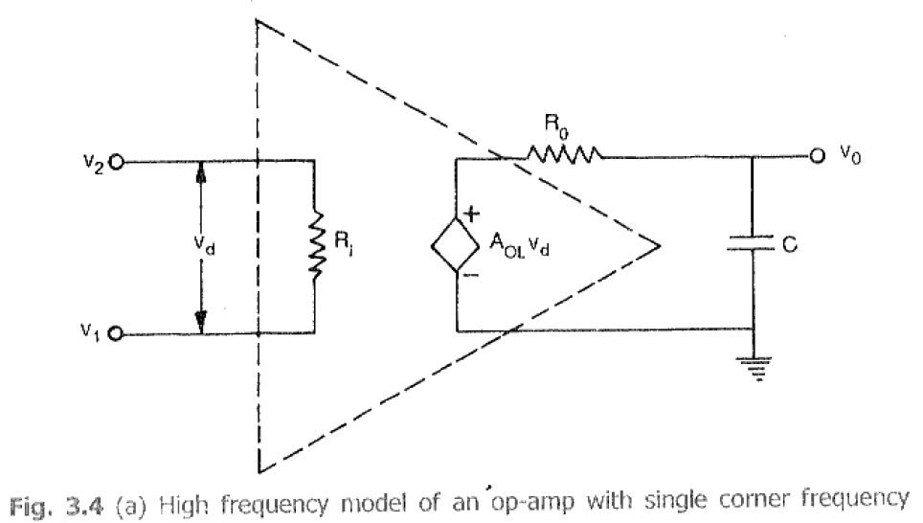
AC Characteristics
Op Amp Frequency Response:

Slide 4
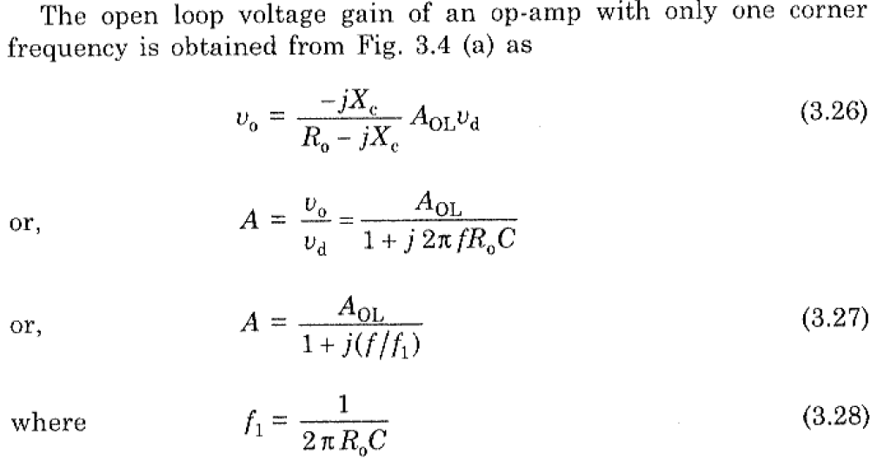
AC Characteristics
Op Amp Frequency Response:

Slide 5
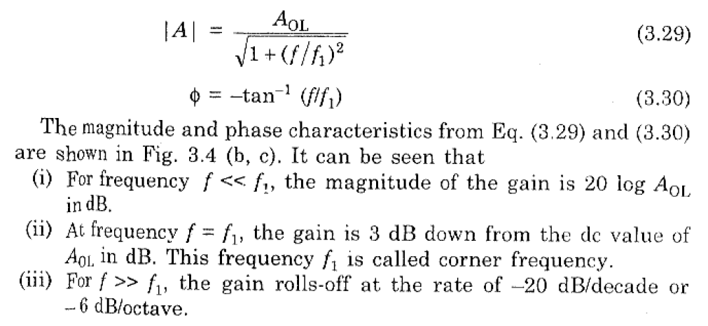
AC Characteristics
Op Amp Frequency Response:

Slide 6
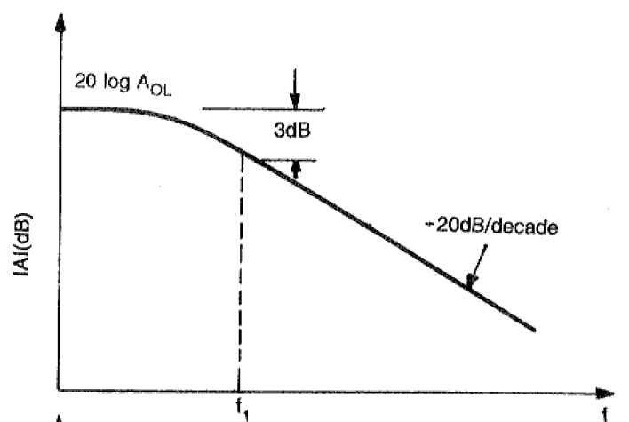
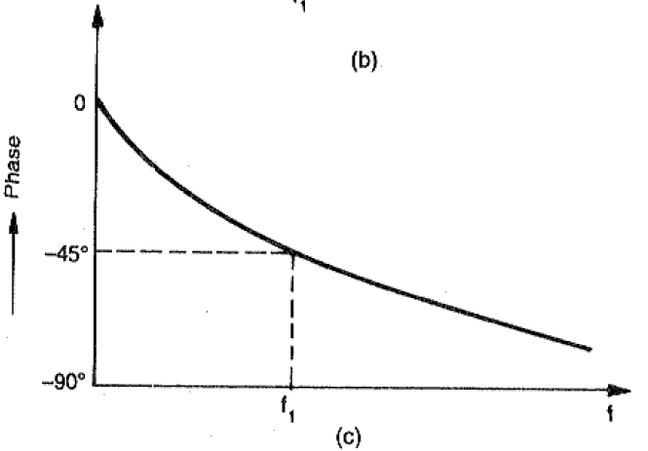
AC Characteristics
Op Amp Frequency Response:

Slide 7
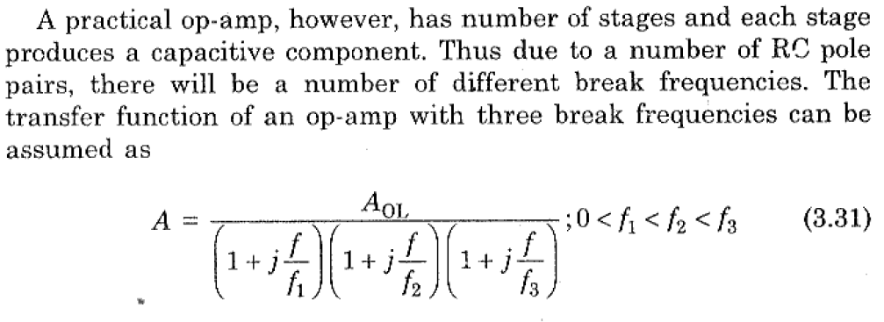
AC Characteristics
Op Amp Frequency Response:

Slide 8
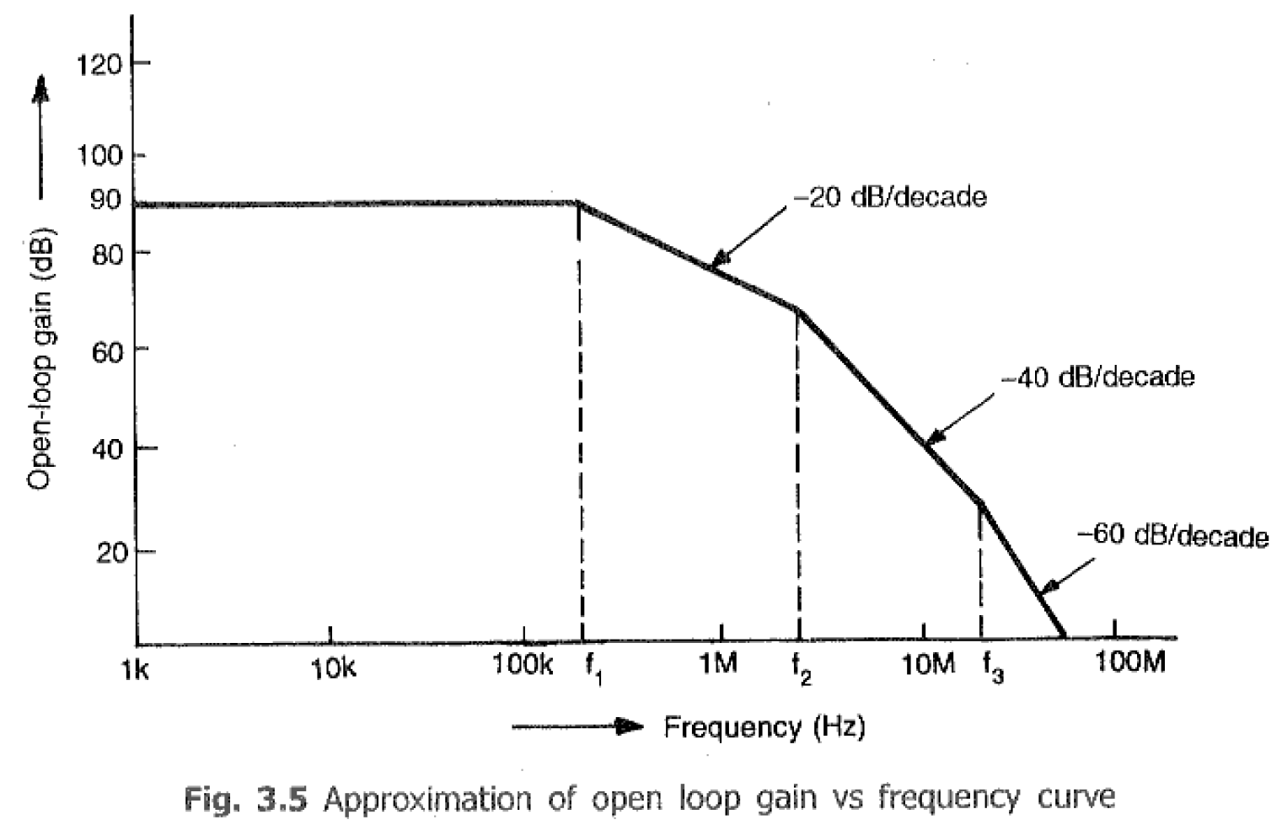
AC Characteristics
Op Amp Frequency Response:

Slide 9
AC Characteristics
Frequency Compensation:
I. External Compensation:
Dominant Pole Compensation
Pole-Zero Compensation
II. Internal Compensation:

Slide 10
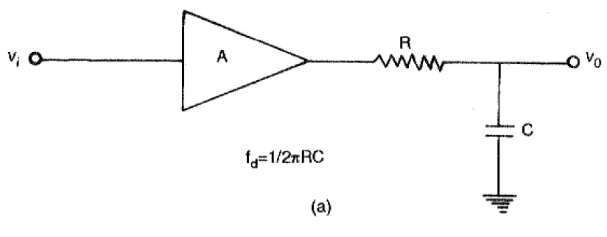
AC Characteristics
I. External Compensation: Dominant Pole Compensation

Slide 11
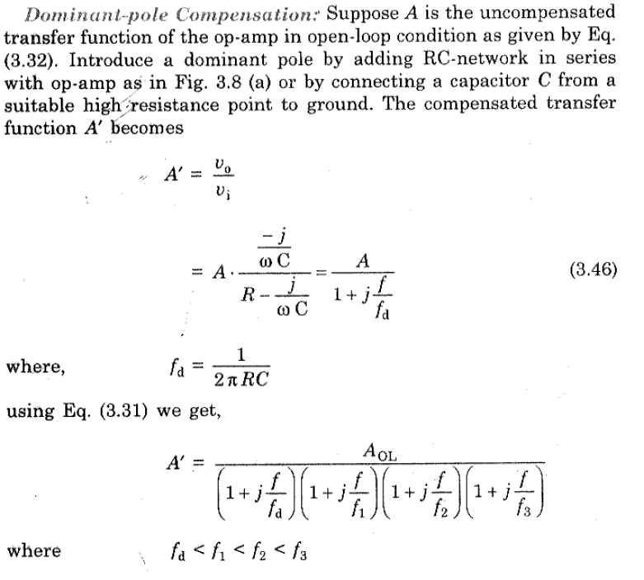
AC Characteristics
I. External Compensation: Dominant Pole Compensation

Slide 12
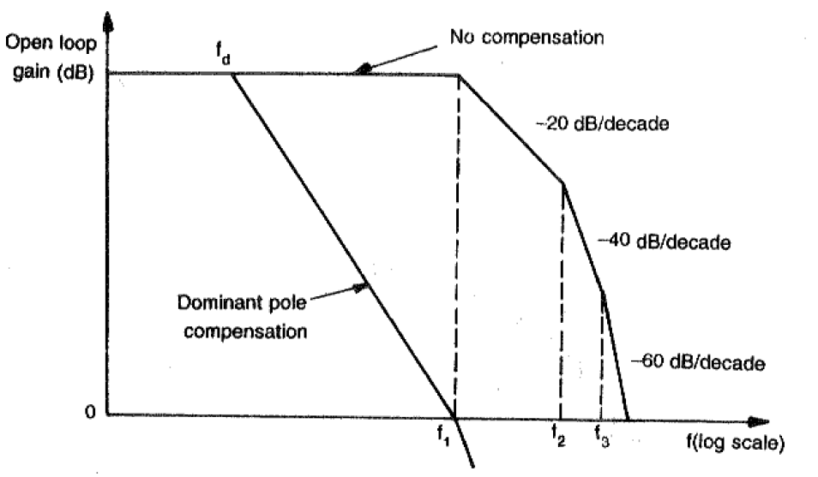
AC Characteristics
I. External Compensation: Dominant Pole Compensation

Slide 13
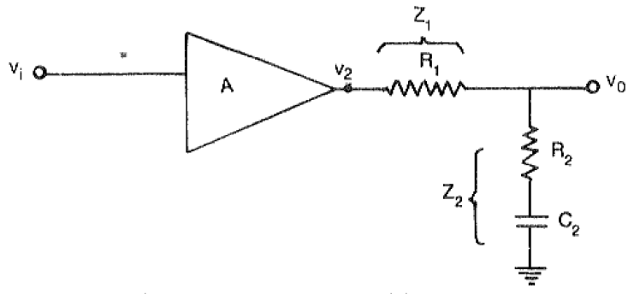
AC Characteristics
I. External Compensation: Pole-Zero Compensation

Slide 14
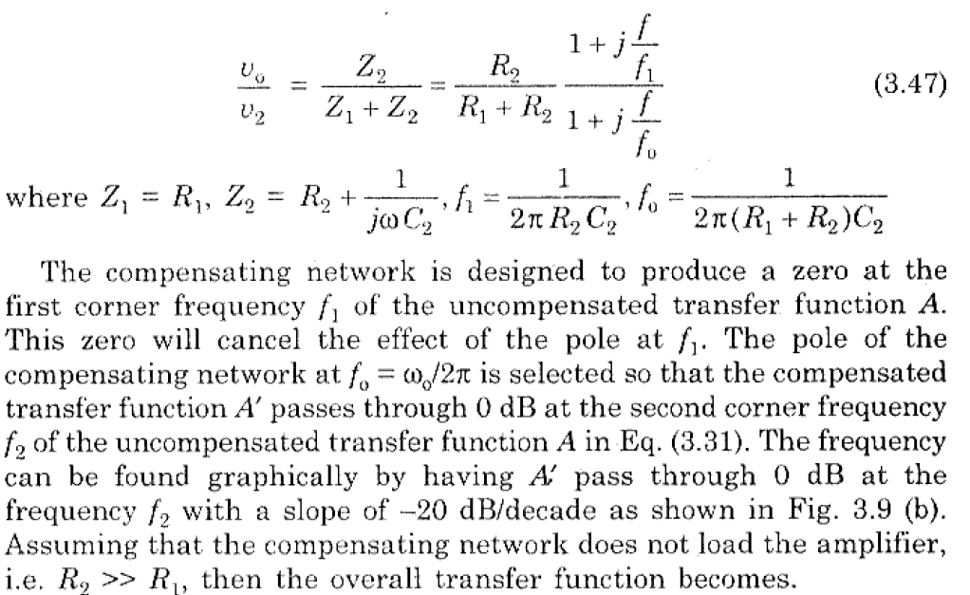
AC Characteristics
I. External Compensation: Pole-Zero Compensation

Slide 15
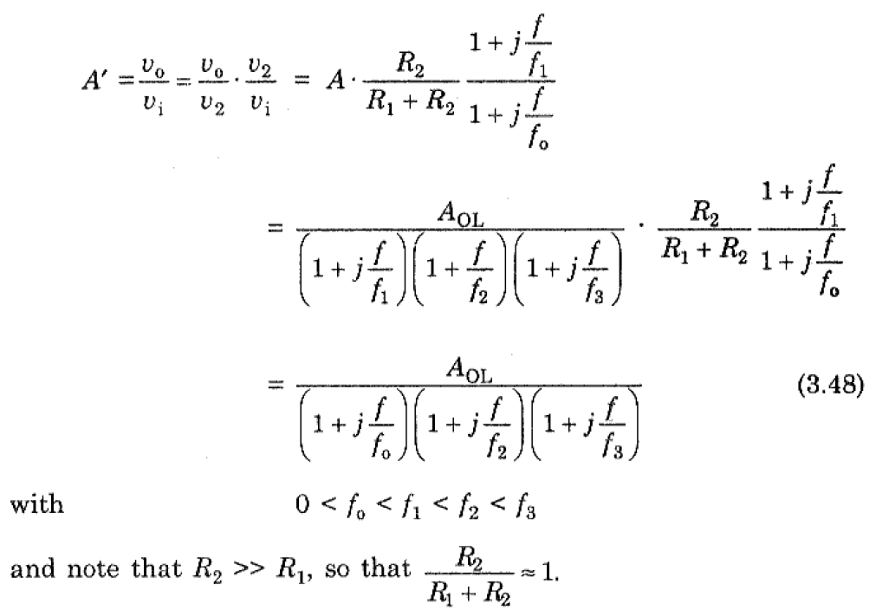
AC Characteristics
I. External Compensation: Pole-Zero Compensation

Slide 16
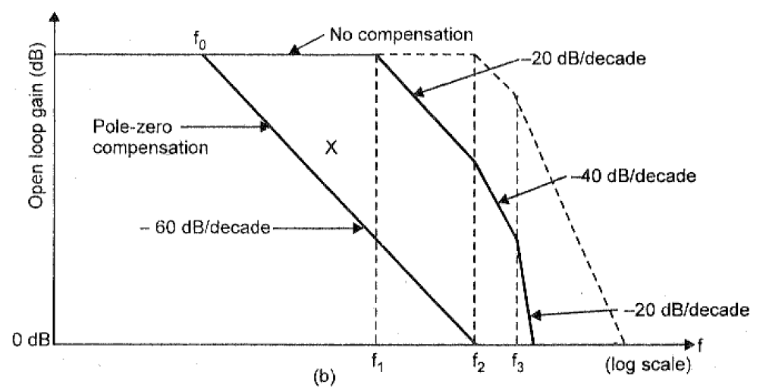
AC Characteristics
I. External Compensation: Pole-Zero Compensation

Slide 17
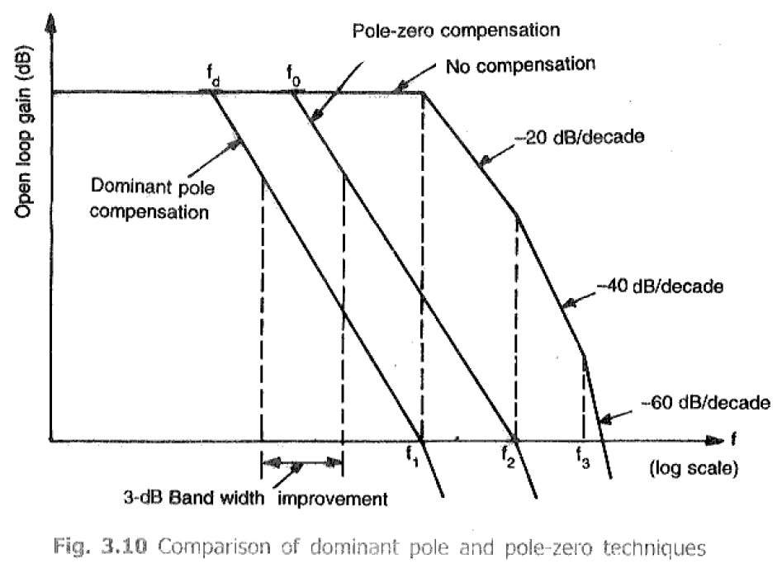
AC Characteristics
I. External Compensation: Pole-Zero Compensation

Slide 18
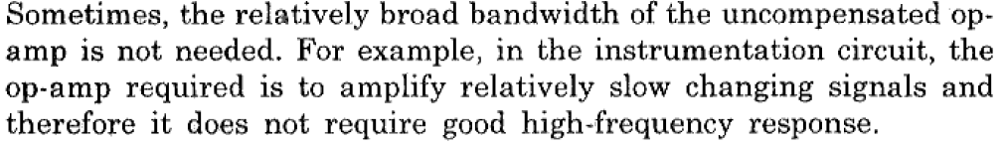
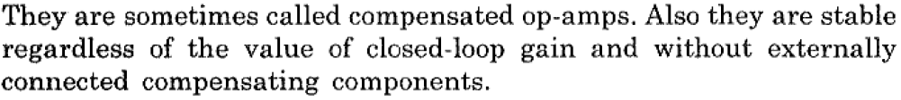
AC Characteristics
II. Internal Compensation:

Slide 19
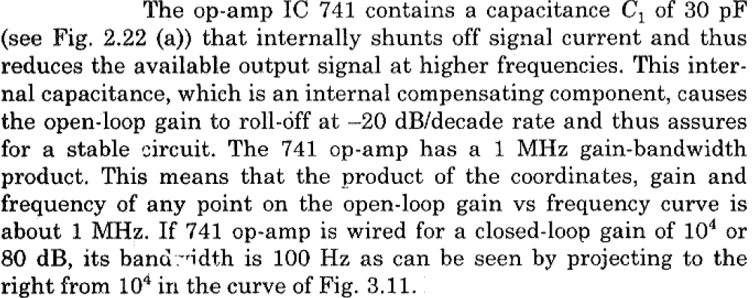
AC Characteristics
II. Internal Compensation:

Slide 20
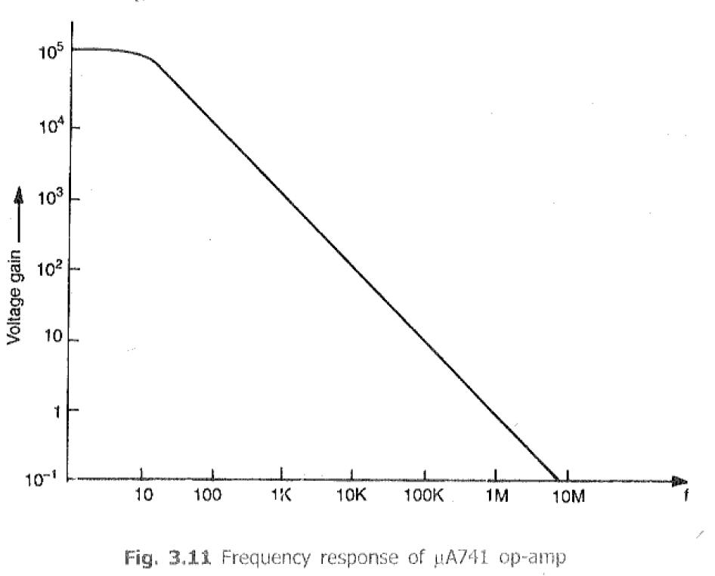
AC Characteristics
II. Internal Compensation:

